Slide 1
Using HUD’s Neighborhood Revitalization Strategy Area (NRSA) to target CDBG Entitlement funds to Distressed and Underserved Areas
Nicole Wyse, Associate Director
City of Detroit, Housing and Revitalization Department
Community Development Division

Slide 2
What is a Neighborhood Revitalization Strategy Area?
HUD refers to NRSAs as “locally designated areas where geographically targeted revitalization efforts are carried out through multiple activities in a concentrated and coordinated manner” (24 CFR 91.215(g))
CDBG Entitlement grantees are able to develop and implement a NRSA per 24 CFR 91.215(g) and NRSAs and their process are further defined in the HUD Notice CPD 16-16
No additional funding comes with a NRSA, however communities with HUD approved NRSAs are offered enhanced flexibility in undertaking economic development, housing and public service activities with their CDBG funding
NRSA plans are 5 year plans, and typically should align with your Con Plan
The creation of a NRSA plan involves heavy citizen participation with stakeholders, affected residents and organizations within the community

Slide 3
NRSA Flexibilities
Aggregation of Housing Units – If 51% or more of all the assisted units in a NRSA during a program year are an LMI benefit, all units are considered as meeting the LMH National Objective. This allows grantees to assist non-LMI households
Jobs as LMA benefit – Job creation/retention activities within a NRSA may qualify as meeting are benefit requirements, eliminating the need for grantees to track the income of persons who take, or are considered for, such jobs
Aggregate Public Benefits Standard – Economic development activities undertaken in a NRSA are exempt from the public benefit standards. This allows grantees some flexibility with their program design and record-keeping requirements
Public Service Cap Exemption – any public service activities undertaken by a Community Based Development Organization (CBDO) in a NRSA are exempt from their 15% public service cap

Slide 4
City of Detroit Economic and Neighborhood Conditions
Detroit has approx. 670,031 residents (population has declined 34% since 1990) and is 139 sq. mi. of land
72% of the population are classified as low-to- moderate income (at or below 80% AMI), the 2015 median household income was $29,841 (half of the nationwide median income)
There are around 365K housing units within the city
93% of the housing stock was built prior to 1978
30% of the housing stock is vacant
The 2015 median value of a home was $43,900 (half the value of homes across Wayne County)
In 2014, the City of Detroit was undergoing post-bankruptcy restructuring and the City struggled with retaining residents for many reasons, including lack of capital flexible enough for home repair and access to jobs
The NRSA plan was considered an important tool to help the city focus its federal resources geographically and leverage private capital

Slide 5
City of Detroit NRSAs Application
The City applied for the HUD NRSA designation in order to:
stabilize the housing stock
increase housing values
grow small businesses
prepare Detroit youth for employment
build wealth for Detroit families
help restore neighborhood stability for Detroit residents
2015, NRSA plan was approved by HUD and included five (5) designated NRSA areas
Based on these demographics, the designated NRSAs met both criteria of having over 70% of residents considered LMI
Neighborhoods with contiguous boundaries that were at least 60% or more primarily residential were considered for NRSA boundaries

Slide 6
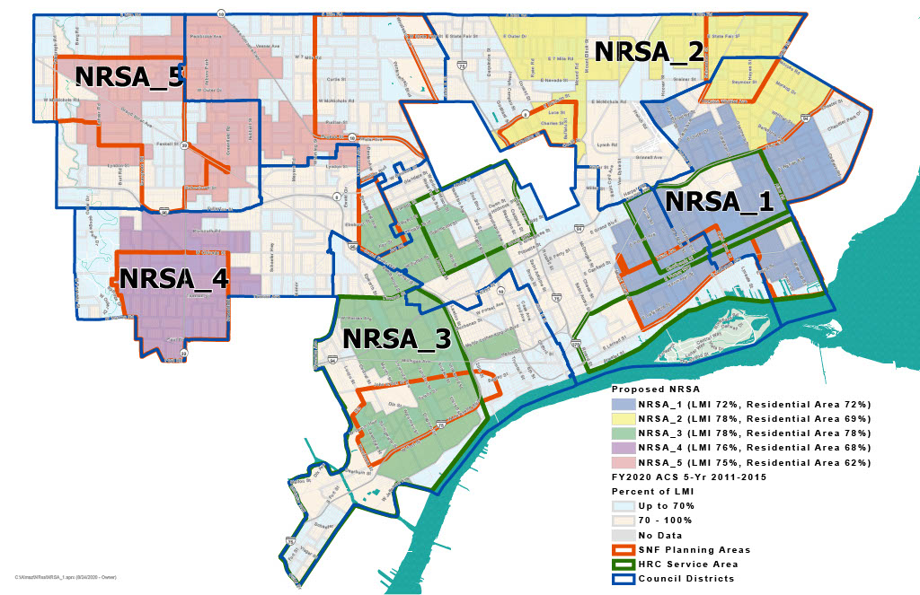
City of Detroit NRSA - Map

Slide 7
City of Detroit NRSA – Current Status
Despite the resurgence in Downtown Detroit since 2015, slum and blighted conditions, undervalued properties and a high poverty rates continue to be a concern in the neighborhoods
The NRSAs demonstrated measurable impact in targeted neighborhoods from 2014-2019, but the City still needed access to this tool to continue that progress
In addition, the increase in public-private partnerships has increased the investment from the private sector in the NRSA areas. Partners including DLBA, DEGC, DESC, foundations, financial institutions, community-based organizations and private businesses have committed to continue work in Detroit neighborhoods
Initiatives including the Strategic Neighborhood Fund (SNF), Affordable Housing Leverage Fund (AHLF), Choice Neighborhoods Implementation Grant (CNI) and the Housing Resource Centers (HRC) that overlap NRSA boundaries
In December 2020, Detroit submitted a renewal application for its NRSA plan, and HUD approved a renewal on the NRSA plan in 2021

Slide 8
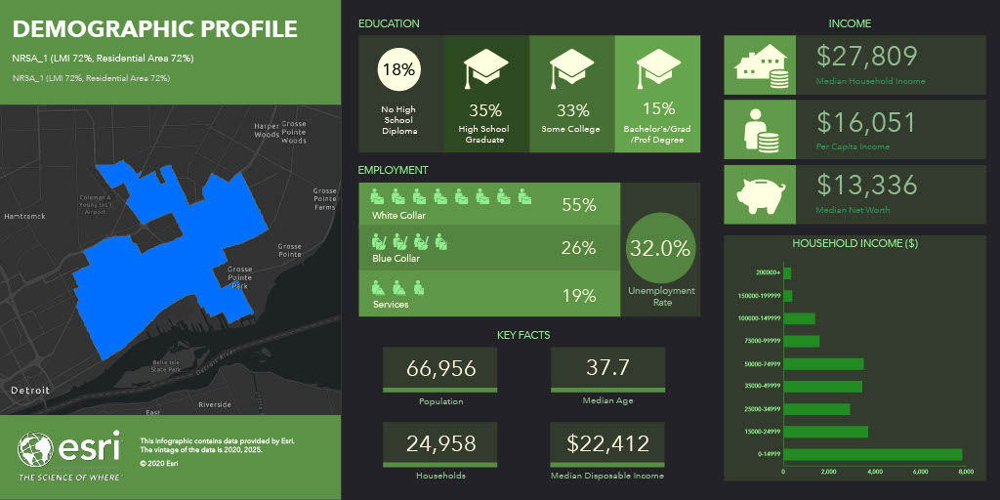
City of Detroit NRSA – Example NRSA 1
75% LMI Rate
Fiat Chrysler Engine Plant
3 SNF Neighborhoods
2 HRC’s
Area slated for major commercial corridor improvements, housing development, streetscape and park improvements
Notes:
Located on the City’s Southeast side, NRSA 1 is bound on the East by Mt. Elliott Street, south by McNichol’s Rd., west by Cadieux Rd, and Gratiot Ave. near the north. While there is an increase in near-term and long-term investment, NRSA 1 shares a 75 percent LMI rate. NRSA is the home to the FCA Mack Engine Plan, the Marina District and in addition, this NRSA makes up three (3) SNF neighborhoods, which include the Jefferson Chalmer neighborhood, East Warren/Cadieux, and Islandview/Greater Villages neighborhoods. Two (2) Housing Resource Centers are currently working within the NRSA 1 boundaries.
The Jefferson Chalmers neighborhood – a national historic designation – is currently slated for significant redevelopment that includes commercial corridor improvements, single family, and multi-family revitalization improvements. Jefferson Chalmers has a strong presence of community block clubs and civic engagement.
The East Warren/Cadieux area includes neighborhoods such as East English Village, West Village, and the Morningside neighborhood; the I-94 corridor runs just north of this area. The Islandview/Greater Village is slated for park renovations, single family and duplex rehabilitation and streetscape improvements.

Slide 9
City of Detroit NRSA – Example NRSA 1
Between 2014-2019
66 owner-occupied single family homes repaired
697 single family demolitions
25 commercial demolitions
40 small businesses received technical assistance
64 jobs created
Notes:
Located on the City’s Southeast side, NRSA 1 is bound on the East by Mt. Elliott Street, south by McNichol’s Rd., west by Cadieux Rd, and Gratiot Ave. near the north. While there is an increase in near-term and long-term investment, NRSA 1 shares a 75 percent LMI rate. NRSA is the home to the FCA Mack Engine Plan, the Marina District and in addition, this NRSA makes up three (3) SNF neighborhoods, which include the Jefferson Chalmer neighborhood, East Warren/Cadieux, and Islandview/Greater Villages neighborhoods. Two (2) Housing Resource Centers are currently working within the NRSA 1 boundaries.
The Jefferson Chalmers neighborhood – a national historic designation – is currently slated for significant redevelopment that includes commercial corridor improvements, single family, and multi-family revitalization improvements. Jefferson Chalmers has a strong presence of community block clubs and civic engagement.
The East Warren/Cadieux area includes neighborhoods such as East English Village, West Village, and the Morningside neighborhood; the I-94 corridor runs just north of this area. The Islandview/Greater Village is slated for park renovations, single family and duplex rehabilitation and streetscape improvements.

Slide 10
City of Detroit NRSA programs highlighted
Home Repair - 0% Home Repair Loan Program (Partner – Detroit LISC, local CDFIs and HRCs)
Established in 2015 to support low, moderate and middle income homeowners with much needed repairs of their home due to the aging housing stock and lack of access to capital for repairs
Property rehabilitation contributes to stabilizing neighborhood housing markets and improving housing values
0% Interest Home Repair Loans are between $5,000 - $25,000 and are paid back over a 10-year term

Slide 11
City of Detroit NRSA programs highlighted
Serves approx. 100 residents annually
Leveraged funding from Bank of America and Quicken Loans ($10M)
800 loans approved, 515 home repairs completed
Average household incomes range between 30% AMI up to 120% AMI
Additional $12.5M in CDBG and $8M in leveraged funds expected over the next 5 years
More information on the 0% Home Repair Loan Program can be found at www.detroithomeloans.org

Slide 12
City of Detroit NRSA programs highlighted
Workforce Development (Youth Employment) - Grow Detroit's Young Talent (Partner – Detroit Employment Solutions Corporation (DESC), 30 partners, 548 jobsites):
DESC is part of the Michigan Works Association and serves as the workforce development agency for the City of Detroit
Through partnerships with community based organizations, DESC provides employers access to Detroit talent
Employs 8,000+ Detroit youth annually
$7.5M in CDBG invested since 2015, $55M leveraged

Slide 13
City of Detroit NRSA programs highlighted
GDYT is for Detroit youth ages 14-24 who have pre-determined barriers to employment
GDYT works on developing soft skills needed to gain employment including: Professionalism, Time & Attendance, Financial Literacy, Customer Service, Hygiene & Workplace Appearance, Communication and Interpersonal Skills
Once the participant has successfully completed this they then graduate on to working.
Wide range of opportunities available (retail, office, food service)
Pays $8.25/hr-$10/hr up to 120 hours during the program cycle
More information on GDYT can be found at www.gdyt.org

Slide 14
Looking Ahead: City of Detroit NRSA next steps
2014-2019 Outcomes for all 5 NRSAs:
605 homes received home repair resources
9,223 single family structures demolished
344 commercial structures demolished
Employment opportunities created for 5,000+ youth
453 new jobs created
234 small businesses assisted
2020-2024 Goals for all 5 NRSAs:
Target another 875 housing units with loans and grants
Demolish another 100 structures
Create another 5,000 employment opportunities for Youth who live in NRSAs
Create 75 new jobs
Assist 500 small businesses

Slide 15
Thank you!
Nicole Wyse, Associate Director
City of Detroit
Housing and Revitalization Department
Community Development Division
313-224-4159
roddenbowenn@detroitmi.gov

